Slide 1

Chapter 10
Trees

Slide 2
Chapter Scope
Trees as data structures
Tree terminology
Tree implementations
Analyzing tree efficiency
Tree traversals
Expression trees

Slide 3
Trees
A tree is a non-linear structure in which elements are organized into a hierarchy
A tree is comprised of a set of nodes in which elements are stored and edges connect one node to another
Each node is located on a particular level
There is only one root node in the tree

Slide 4
Trees
Nodes at the lower level of a tree are the children of nodes at the previous level
A node can have only one parent, but may have multiple children
Nodes that have the same parent are siblings
The root is the only node which has no parent

Slide 5
Trees
A node that has no children is a leaf node
A note that is not the root and has at least one child is an internal node
A subtree is a tree structure that makes up part of another tree
We can follow a path through a tree from parent to child, starting at the root
A node is an ancestor of another node if it is above it on the path from the root.

Slide 6
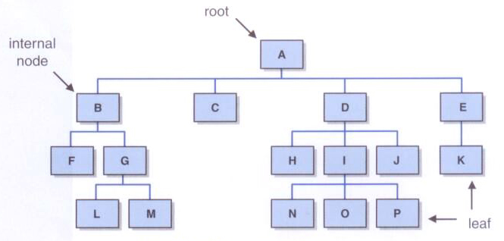
Trees

Slide 7
Trees
Nodes that can be reached by following a path from a particular node are the descendants of that node
The level of a node is the length of the path from the root to the node
The path length is the number of edges followed to get from the root to the node
The height of a tree is the length of the longest path from the root to a leaf

Slide 8
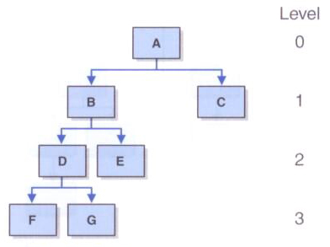
Trees

Slide 9
Classifying Trees
Trees can be classified in many ways
One important criterion is the maximum number of children any node in the tree may have
This may be referred to as the order of the tree
General trees have no limit to the number of children a node may have
A tree that limits each node to no more than n children is referred to as an n-ary tree

Slide 10
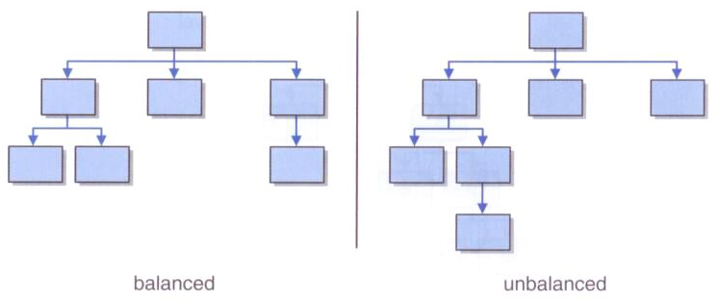
Balanced Trees
Trees in which nodes may have at most two children are called binary trees
A tree is balanced if all of the leaves of the tree are on the same level or within one level of each other

Slide 11
Full and Complete Trees
A balanced n-ary tree with m elements will have a height of log_{n}m
A balanced binary tree with n nodes has a height of log₂n
An n-ary tree is full if all leaves of the tree are at the same height and every non-leaf node has exactly n children
A tree is complete if it is full, or full to the next-to-last level with all leaves at the bottom level on the left side of the tree

Slide 12
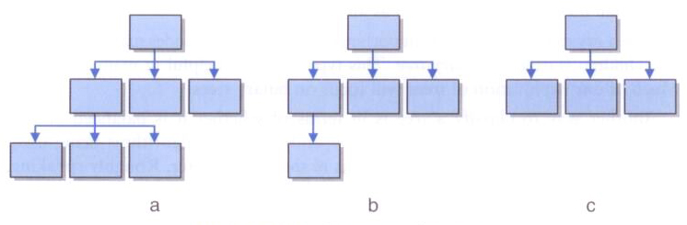
Full and Complete Trees
Three complete trees:
Only tree c is full

Slide 13
Implementing Trees
An obvious choice for implementing trees is a linked structure
Array-based implementations are the less obvious choice, but are sometimes useful
Let's first look at the strategy behind two array-based implementations

Slide 14
Computed Child Links
For full or complete binary trees, we can use an array to represent a tree
For any element stored in position n,
the element’s left child is stored in array position (2n+1)
the element’s right child is stored in array position (2*(n+1))
If the represented tree is not complete or relatively complete, this approach can waste large amounts of array space

Slide 15
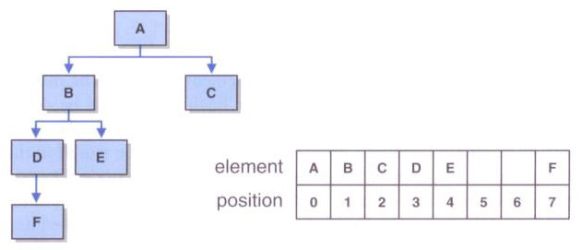
Computed Child Links

Slide 16
Simulated Child Links
Each element of the array is an object that stores a reference to the tree element and the array index of each child
This approach is modeled after the way operating systems manage memory
Array positions are allocated on a first-come, first-served basis

Slide 17
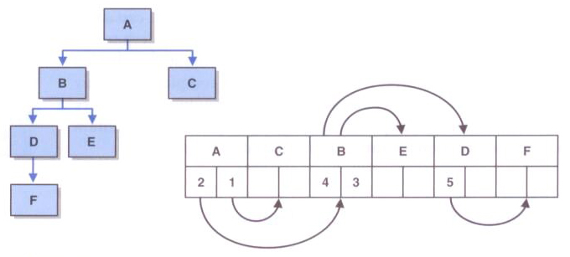
Simulated Child Links

Slide 18
Tree Traversals
For linear structures, the process of iterating through the elements is fairly obvious (forwards or backwards)
For non-linear structures like a tree, the possibilities are more interesting
Let's look at four classic ways of traversing the nodes of a tree
All traversals start at the root of the tree
Each node can be thought of as the root of a subtree

Slide 19
Tree Traversals
Preorder: visit the root, then traverse the subtrees from left to right
Inorder: traverse the left subtree, then visit the root, then traverse the right subtree
Postorder: traverse the subtrees from left to right, then visit the root
Level-order: visit each node at each level of the tree from top (root) to bottom and left to right

Slide 20
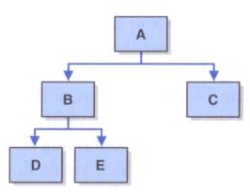
Tree Traversals
Preorder: A B D E C
Inorder: D B E A C
Postorder: D E B C A
Level-Order: A B C D E

Slide 21
Tree Traversals
Recursion simplifies the implementation of tree traversals
Preorder (pseudocode):
Visit node
Traverse (left child)
Traverse (right child)
Inorder:
Traverse (left child)
Visit node
Traverse (right child)

Slide 22
Tree Traversals
Postorder:
Traverse (left child)
Traverse (right child)
Visit node
A level-order traversal is more complicated
It requires the use of extra structures (such as queues and/or lists) to create the necessary order

Slide 23
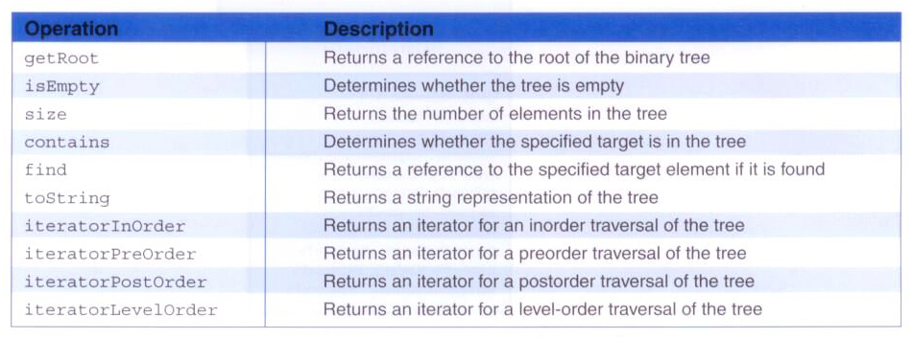
A Binary Tree ADT

Slide 24
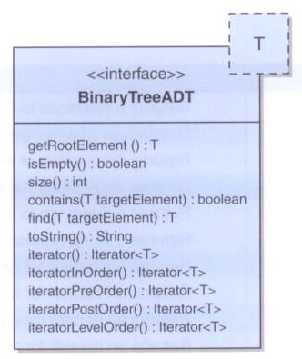
A Binary Tree ADT

Slide 25
package jsjf;
import java.util.Iterator;
/**
* BinaryTreeADT defines the interface to a binary tree data structure.
*
* @author Lewis and Chase
* @version 4.0
*/
public interface BinaryTreeADT<T>
{
/**
* Returns a reference to the root element
*
* @return a reference to the root
*/
public T getRootElement();
/**
* Returns true if this binary tree is empty and false otherwise.
*
* @return true if this binary tree is empty, false otherwise
*/
public boolean isEmpty();

Slide 26
/**
* Returns the number of elements in this binary tree.
*
* @return the number of elements in the tree
*/
public int size();
/**
* Returns true if the binary tree contains an element that matches
* the specified element and false otherwise.
*
* @param targetElement the element being sought in the tree
* @return true if the tree contains the target element
*/
public boolean contains(T targetElement);
/**
* Returns a reference to the specified element if it is found in
* this binary tree. Throws an exception if the specified element
* is not found.
*
* @param targetElement the element being sought in the tree
* @return a reference to the specified element
*/
public T find(T targetElement);

Slide 27
/**
* Returns the string representation of this binary tree.
*
* @return a string representation of the binary tree
*/
public String toString();
/**
* Returns an iterator over the elements of this tree.
*
* @return an iterator over the elements of this binary tree
*/
public Iterator<T> iterator();
/**
* Returns an iterator that represents an inorder traversal on this binary tree.
*
* @return an iterator over the elements of this binary tree
*/
public Iterator<T> iteratorInOrder();
/**
* Returns an iterator that represents a preorder traversal on this binary tree.
*
* @return an iterator over the elements of this binary tree
*/
public Iterator<T> iteratorPreOrder();

Slide 28
/**
* Returns an iterator that represents a postorder traversal on this binary tree.
*
* @return an iterator over the elements of this binary tree
*/
public Iterator<T> iteratorPostOrder();
/**
* Returns an iterator that represents a levelorder traversal on the binary tree.
*
* @return an iterator over the elements of this binary tree
*/
public Iterator<T> iteratorLevelOrder();
}

Slide 29
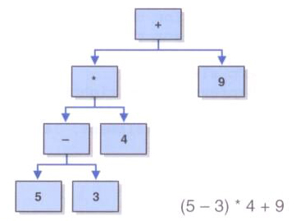
Expression Trees
An expression tree is a tree that shows the relationships among operators and operands in an expression
An expression tree is evaluated from the bottom up

Slide 30
import jsjf.*;
/**
* ExpressionTree represents an expression tree of operators and operands.
*
* @author Lewis and Chase
* @version 4.0
*/
public class ExpressionTree extends LinkedBinaryTree<ExpressionTreeOp>
{
/**
* Creates an empty expression tree.
*/
public ExpressionTree()
{
super();
}

Slide 31
/**
* Constructs a expression tree from the two specified expression
* trees.
*
* @param element the expression tree for the center
* @param leftSubtree the expression tree for the left subtree
* @param rightSubtree the expression tree for the right subtree
*/
public ExpressionTree(ExpressionTreeOp element,
ExpressionTree leftSubtree, ExpressionTree rightSubtree)
{
root = new BinaryTreeNode<ExpressionTreeOp>(element, leftSubtree, rightSubtree);
}
/**
* Evaluates the expression tree by calling the recursive
* evaluateNode method.
*
* @return the integer evaluation of the tree
*/
public int evaluateTree()
{
return evaluateNode(root);
}

Slide 32
/**
* Recursively evaluates each node of the tree.
*
* @param root the root of the tree to be evaluated
* @return the integer evaluation of the tree
*/
public int evaluateNode(BinaryTreeNode root)
{
int result, operand1, operand2;
ExpressionTreeOp temp;
if (root==null)
result = 0;
else
{
temp = (ExpressionTreeOp)root.getElement();
if (temp.isOperator())
{
operand1 = evaluateNode(root.getLeft());
operand2 = evaluateNode(root.getRight());
result = computeTerm(temp.getOperator(), operand1, operand2);
}
else
result = temp.getValue();
}
return result;
}

Slide 33
/**
* Evaluates a term consisting of an operator and two operands.
*
* @param operator the operator for the expression
* @param operand1 the first operand for the expression
* @param operand2 the second operand for the expression
*/
private static int computeTerm(char operator, int operand1, int operand2)
{
int result=0;
if (operator == '+')
result = operand1 + operand2;
else if (operator == '-')
result = operand1 - operand2;
else if (operator == '*')
result = operand1 * operand2;
else
result = operand1 / operand2;
return result;
}

Slide 34
/**
* Generates a structured string version of the tree by performing
* a levelorder traversal.
*
* @return a string representation of this binary tree
*/
public String printTree()
{
UnorderedListADT<BinaryTreeNode<ExpressionTreeOp>> nodes =
new ArrayUnorderedList<BinaryTreeNode<ExpressionTreeOp>>();
UnorderedListADT<Integer> levelList =
new ArrayUnorderedList<Integer>();
BinaryTreeNode<ExpressionTreeOp> current;
String result = "";
int printDepth = this.getHeight();
int possibleNodes = (int)Math.pow(2, printDepth + 1);
int countNodes = 0;
nodes.addToRear(root);
Integer currentLevel = 0;
Integer previousLevel = -1;
levelList.addToRear(currentLevel);

Slide 35
while (countNodes < possibleNodes)
{
countNodes = countNodes + 1;
current = nodes.removeFirst();
currentLevel = levelList.removeFirst();
if (currentLevel > previousLevel)
{
result = result + "\n\n";
previousLevel = currentLevel;
for (int j = 0; j < ((Math.pow(2, (printDepth - currentLevel))) - 1); j++)
result = result + " ";
}
else
{
for (int i = 0; i < ((Math.pow(2, (printDepth - currentLevel + 1)) - 1)) ; i++)
{
result = result + " ";
}
}
if (current != null)
{
result = result + (current.getElement()).toString();
nodes.addToRear(current.getLeft());
levelList.addToRear(currentLevel + 1);
nodes.addToRear(current.getRight());
levelList.addToRear(currentLevel + 1);
}

Slide 36
else
{
nodes.addToRear(null);
levelList.addToRear(currentLevel + 1);
nodes.addToRear(null);
levelList.addToRear(currentLevel + 1);
result = result + " ";
}
}
return result;
}
}

Slide 37
import jsjf.*;
/**
* ExpressionTreeOp represents an element in an expression tree.
*
* @author Lewis and Chase
* @version 4.0
*/
public class ExpressionTreeOp
{
private int termType;
private char operator;
private int value;
/**
* Creates a new expression tree object with the specified data.
*
* @param type the integer type of the expression
* @param op the operand for the expression
* @param val the value for the expression
*/
public ExpressionTreeOp(int type, char op, int val)
{
termType = type;
operator = op;
value = val;
}

Slide 38
/**
* Returns true if this object is an operator and false otherwise.
*
* @return true if this object is an operator, false otherwise
*/
public boolean isOperator()
{
return (termType == 1);
}
/**
*Returns the operator of this expression tree object.
*
* @return the character representation of the operator
*/
public char getOperator()
{
return operator;
}
/**
* Returns the value of this expression tree object.
*
* @return the value of this expression tree object
*/
public int getValue()
{
return value;
}

Slide 39
public String toString()
{
if (termType == 1)
return operator + "";
else
return value + "";
}
}

Slide 40
Expression Tree Evaluation
Let's look at an example that creates an expression tree from a postfix expression and then evaluates it
This is a modification of an earlier solution
It uses a stack of expression trees to build the complete expression tree

Slide 41
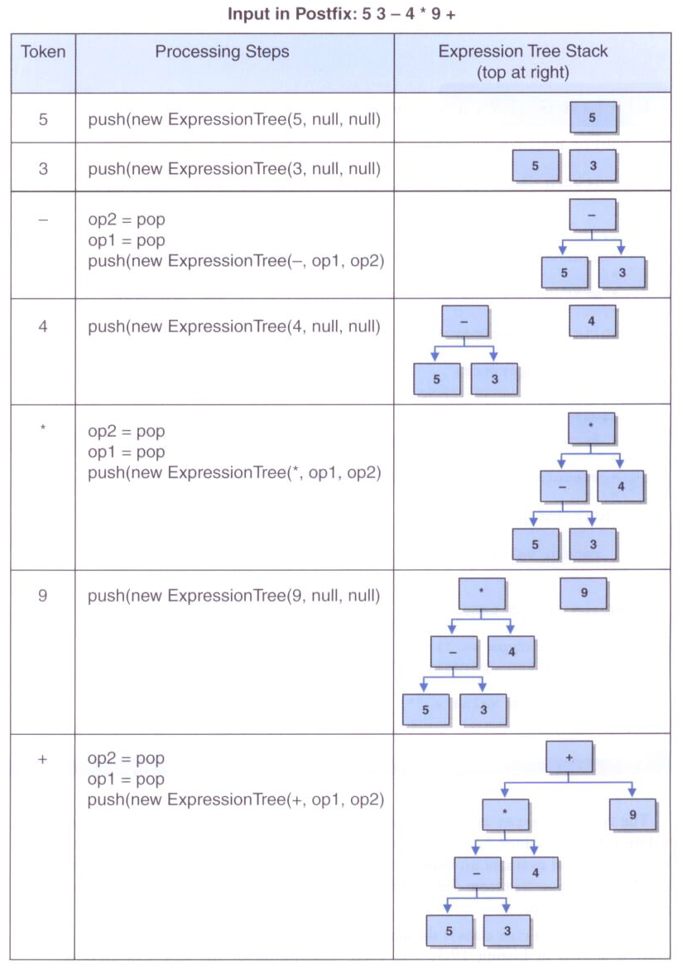
xxx

Slide 42
import java.util.Scanner;
/**
* Demonstrates the use of an expression tree to evaluate postfix expressions.
*
* @author Lewis and Chase
* @version 4.0
*/
public class PostfixTester
{
/**
* Reads and evaluates multiple postfix expressions.
*/
public static void main(String[] args)
{
String expression, again;
int result;
Scanner in = new Scanner(System.in);
do
{
PostfixEvaluator evaluator = new PostfixEvaluator();
System.out.println("Enter a valid post-fix expression one token " +
"at a time with a space between each token (e.g. 5 4 + 3 2 1 - + *)");
System.out.println("Each token must be an integer or an operator (+,-,*,/)");
expression = in.nextLine();

Slide 43
result = evaluator.evaluate(expression);
System.out.println();
System.out.println("That expression equals " + result);
System.out.println("The Expression Tree for that expression is: ");
System.out.println(evaluator.getTree());
System.out.print("Evaluate another expression [Y/N]? ");
again = in.nextLine();
System.out.println();
}
while (again.equalsIgnoreCase("y"));
}
}

Slide 44
import jsjf.*;
import jsjf.exceptions.*;
import java.util.*;
import java.io.*;
/**
* PostfixEvaluator this modification of our stack example uses a
* stack to create an expression tree from a VALID integer postfix expression
* and then uses a recursive method from the ExpressionTree class to
* evaluate the tree.
*
* @author Lewis and Chase
* @version 4.0
*/
public class PostfixEvaluator
{
private String expression;
private Stack<ExpressionTree> treeStack;
/**
* Sets up this evalutor by creating a new stack.
*/
public PostfixEvaluator()
{
treeStack = new Stack<ExpressionTree>();
}

Slide 45
/**
* Retrieves and returns the next operand off of this tree stack.
*
* @param treeStack the tree stack from which the operand will be returned
* @return the next operand off of this tree stack
*/
private ExpressionTree getOperand(Stack<ExpressionTree> treeStack)
{
ExpressionTree temp;
temp = treeStack.pop();
return temp;
}
/**
* Evaluates the specified postfix expression by building and evaluating
* an expression tree.
*
* @param expression string representation of a postfix expression
* @return value of the given expression
*/
public int evaluate(String expression)
{
ExpressionTree operand1, operand2;
char operator;
String tempToken;
Scanner parser = new Scanner(expression);

Slide 46
while (parser.hasNext())
{
tempToken = parser.next();
operator = tempToken.charAt(0);
if ((operator == '+') || (operator == '-') || (operator == '*') ||
(operator == '/'))
{
operand1 = getOperand(treeStack);
operand2 = getOperand(treeStack);
treeStack.push(new ExpressionTree
(new ExpressionTreeOp(1,operator,0), operand2, operand1));
}
else
{
treeStack.push(new ExpressionTree(new ExpressionTreeOp
(2,' ',Integer.parseInt(tempToken)), null, null));
}
}
return (treeStack.peek()).evaluateTree();
}
/**
* Returns the expression tree associated with this postfix evaluator.
*
* @return string representing the expression tree
*/
public String getTree()
{
return (treeStack.peek()).printTree();
}
}

Slide 47
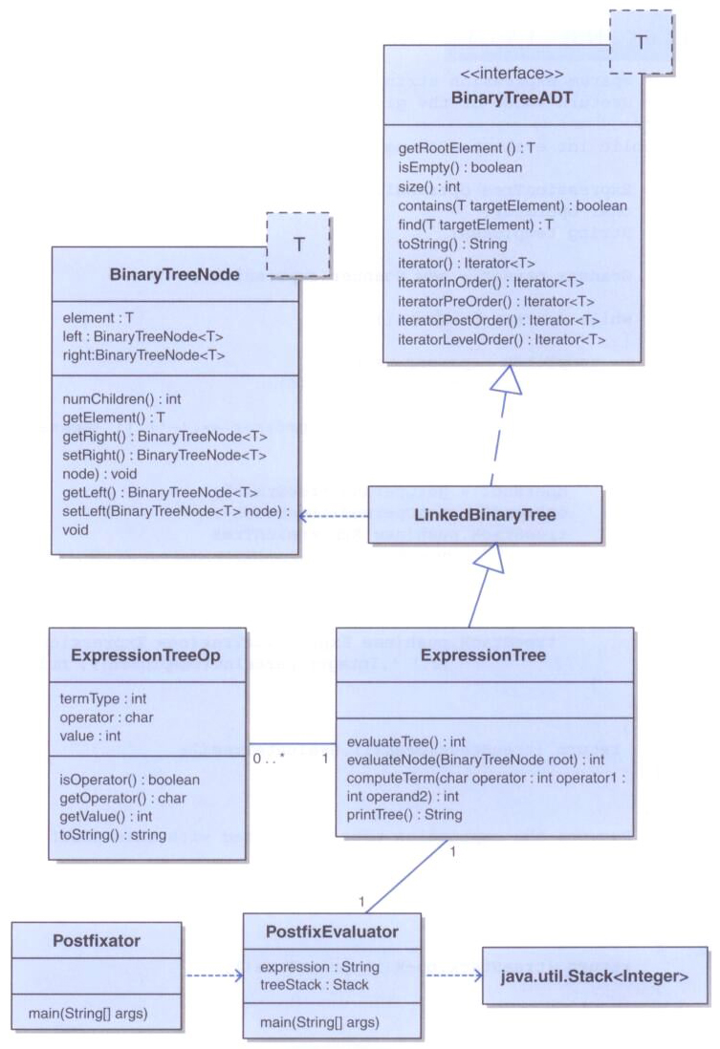
xxx

Slide 48
Decision Trees
A decision tree is a tree whose nodes represent decision points, and whose children represent the options available
The leaves of a decision tree represent the possible conclusions that might be drawn
A simple decision tree, with yes/no questions, can be modeled by a binary tree
Decision trees are useful in diagnostic situations (medical, car repair, etc.)

Slide 49

Decision Trees
A simplified decision tree for diagnosing back pain:

Slide 50
import java.io.*;
/**
* BackPainAnaylyzer demonstrates the use of a binary decision tree to
* diagnose back pain.
*/
public class BackPainAnalyzer
{
/**
* Asks questions of the user to diagnose a medical problem.
*/
public static void main (String[] args) throws FileNotFoundException
{
System.out.println ("So, you're having back pain.");
DecisionTree expert = new DecisionTree("input.txt");
expert.evaluate();
}
}

Slide 51
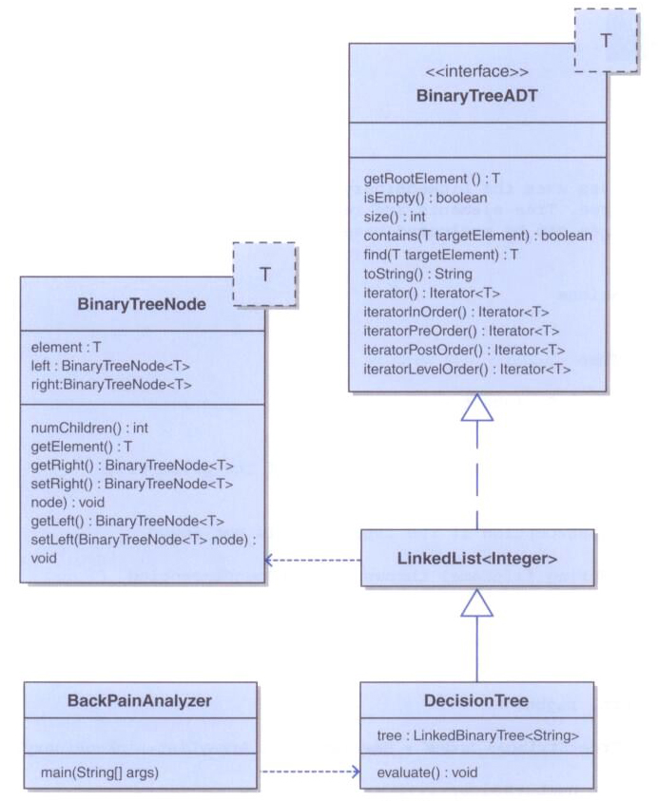

Slide 52
import jsjf.*;
import java.util.*;
import java.io.*;
/**
* The DecisionTree class uses the LinkedBinaryTree class to implement
* a binary decision tree. Tree elements are read from a given file and
* then the decision tree can be evaluated based on user input using the
* evaluate method.
*
* @author Lewis and Chase
* @version 4.0
*/
public class DecisionTree
{
private LinkedBinaryTree<String> tree;
/**
* Builds the decision tree based on the contents of the given file
*
* @param filename the name of the input file
* @throws FileNotFoundException if the input file is not found
*/
public DecisionTree(String filename) throws FileNotFoundException
{
File inputFile = new File(filename);
Scanner scan = new Scanner(inputFile);

Slide 53
int numberNodes = scan.nextInt();
scan.nextLine();
int root = 0, left, right;
List<LinkedBinaryTree<String>> nodes = new
java.util.ArrayList<LinkedBinaryTree<String>>();
for (int i = 0; i < numberNodes; i++)
nodes.add(i,new LinkedBinaryTree<String>(scan.nextLine()));
while (scan.hasNext())
{
root = scan.nextInt();
left = scan.nextInt();
right = scan.nextInt();
scan.nextLine();
nodes.set(root, new LinkedBinaryTree<String>((nodes.get(root)).getRootElement(),
nodes.get(left), nodes.get(right)));
}
tree = nodes.get(root);
}

Slide 54
/**
* Follows the decision tree based on user responses.
*/
public void evaluate()
{
LinkedBinaryTree<String> current = tree;
Scanner scan = new Scanner(System.in);
while (current.size() > 1)
{
System.out.println (current.getRootElement());
if (scan.nextLine().equalsIgnoreCase("N"))
current = current.getLeft();
else
current = current.getRight();
}
System.out.println (current.getRootElement());
}
}

Slide 55
Implementing Binary Trees with Links
Now let's explore an implementation of a binary tree using links
The LinkedBinaryTree class holds a reference to the root node
The BinaryTreeNode class represents each node, with links to a possible left and/or right child

Slide 56
package jsjf;
/**
* BinaryTreeNode represents a node in a binary tree with a left and
* right child.
*
* @author Lewis and Chase
* @version 4.0
*/
public class BinaryTreeNode<T>
{
protected T element;
protected BinaryTreeNode<T> left, right;
/**
* Creates a new tree node with the specified data.
*
* @param obj the element that will become a part of the new tree node
*/
public BinaryTreeNode(T obj)
{
element = obj;
left = null;
right = null;
}

Slide 57
/**
* Creates a new tree node with the specified data.
*
* @param obj the element that will become a part of the new tree node
* @param left the tree that will be the left subtree of this node
* @param right the tree that will be the right subtree of this node
*/
public BinaryTreeNode(T obj, LinkedBinaryTree<T> left, LinkedBinaryTree<T> right)
{
element = obj;
if (left == null)
this.left = null;
else
this.left = left.getRootNode();
if (right == null)
this.right = null;
else
this.right = right.getRootNode();
}

Slide 58
/**
* Returns the number of non-null children of this node.
*
* @return the integer number of non-null children of this node
*/
public int numChildren()
{
int children = 0;
if (left != null)
children = 1 + left.numChildren();
if (right != null)
children = children + 1 + right.numChildren();
return children;
}
/**
* Return the element at this node.
*
* @return the element stored at this node
*/
public T getElement()
{
return element;
}

Slide 59
/**
* Return the right child of this node.
*
* @return the right child of this node
*/
public BinaryTreeNode<T> getRight()
{
return right;
}
/**
* Sets the right child of this node.
*
* @param node the right child of this node
*/
public void setRight(BinaryTreeNode<T> node)
{
right = node;
}

Slide 60
/**
* Return the left child of this node.
*
* @return the left child of the node
*/
public BinaryTreeNode<T> getLeft()
{
return left;
}
/**
* Sets the left child of this node.
*
* @param node the left child of this node
*/
public void setLeft(BinaryTreeNode<T> node)
{
left = node;
}
}

Slide 61
package jsjf;
import java.util.*;
import jsjf.exceptions.*;
/**
* LinkedBinaryTree implements the BinaryTreeADT interface
*
* @author Lewis and Chase
* @version 4.0
*/
public class LinkedBinaryTree<T> implements BinaryTreeADT<T>, Iterable<T>
{
protected BinaryTreeNode<T> root;
protected int modCount;
/**
* Creates an empty binary tree.
*/
public LinkedBinaryTree()
{
root = null;
}

Slide 62
/**
* Creates a binary tree with the specified element as its root.
*
* @param element the element that will become the root of the binary tree
*/
public LinkedBinaryTree(T element)
{
root = new BinaryTreeNode<T>(element);
}
/**
* Creates a binary tree with the specified element as its root and the
* given trees as its left child and right child
*
* @param element the element that will become the root of the binary tree
* @param left the left subtree of this tree
* @param right the right subtree of this tree
*/
public LinkedBinaryTree(T element, LinkedBinaryTree<T> left,
LinkedBinaryTree<T> right)
{
root = new BinaryTreeNode<T>(element);
root.setLeft(left.root);
root.setRight(right.root);
}

Slide 63
/**
* Returns a reference to the specified target element if it is
* found in this binary tree. Throws a ElementNotFoundException if
* the specified target element is not found in the binary tree.
*
* @param targetElement the element being sought in this tree
* @return a reference to the specified target
* @throws ElementNotFoundException if the element is not in the tree
*/
public T find(T targetElement) throws ElementNotFoundException
{
BinaryTreeNode<T> current = findNode(targetElement, root);
if (current == null)
throw new ElementNotFoundException("LinkedBinaryTree");
return (current.getElement());
}

Slide 64
/**
* Returns a reference to the specified target element if it is
* found in this binary tree.
*
* @param targetElement the element being sought in this tree
* @param next the element to begin searching from
*/
private BinaryTreeNode<T> findNode(T targetElement,
BinaryTreeNode<T> next)
{
if (next == null)
return null;
if (next.getElement().equals(targetElement))
return next;
BinaryTreeNode<T> temp = findNode(targetElement, next.getLeft());
if (temp == null)
temp = findNode(targetElement, next.getRight());
return temp;
}

Slide 65
/**
* Performs an inorder traversal on this binary tree by calling an
* overloaded, recursive inorder method that starts with
* the root.
*
* @return an in order iterator over this binary tree
*/
public Iterator<T> iteratorInOrder()
{
ArrayUnorderedList<T> tempList = new ArrayUnorderedList<T>();
inOrder(root, tempList);
return new TreeIterator(tempList.iterator());
}
/**
* Performs a recursive inorder traversal.
*
* @param node the node to be used as the root for this traversal
* @param tempList the temporary list for use in this traversal
*/
protected void inOrder(BinaryTreeNode<T> node,
ArrayUnorderedList<T> tempList)
{
if (node != null)
{
inOrder(node.getLeft(), tempList);
tempList.addToRear(node.getElement());
inOrder(node.getRight(), tempList);
}
}

